Slide 1

AI CONTENT GENERATOR
Week 2 Bootcamp Project
27th April – 1st May 2026
Tlotliso Mokomabo
Capaciti AI Bootcamp

Slide 2
AGENDA Project Introduction Core Competencies Technical Concepts & Tools Live Demo & Features Prompt Library & Case Study Results & Portfolio

Slide 3

PROJECT INTRODUCTION Project Name: AI Career & Productivity Content Generator Objective: Build a tool that generates professional content (blogs, emails, cover letters, etc.) using AI Technology Stack: HTML5 | CSS3 | JavaScript | Hugging Face API | Netlify Live URL: https://tlotliso-ai-generator.netlify.app

Slide 4

CORE COMPETENCIES DEMONSTRATED Prompt Optimization Structured prompts with parameters Tone and length control AI Content Generation 8 different content types Real-time API integration Fallback generation system Individual Project Ownership Full development lifecycle Deployment to Netlify AI Productivity Workflows One-click content generation Copy to clipboard functionality Prompt library for quick reuse

Slide 5
CORE COMPETENCIES DEMONSTRATED Prompt Optimization Structured prompts with parameters Tone and length control AI Content Generation 8 different content types Real-time API integration Fallback generation system Individual Project Ownership Full development lifecycle Deployment to Netlify AI Productivity Workflows One-click content generation Copy to clipboard functionality Prompt library for quick reuse

Slide 6
CONTENT GENERATOR FEATURES 8 Content Types Blog Post | Email | LinkedIn Post | Cover Letter | Study Notes | Resume Summary | Meeting Agenda | Project Proposal 6 Tone Options Professional | Friendly | Formal | Creative | Urgent | Humorous 3 Length Options Short (2-3 paragraphs) | Medium (4-5 paragraphs) | Long (6-8 paragraphs) Additional Features Copy to Clipboard Collapsible Prompt Library Animated Gradient Background Mobile Responsive Design

Slide 7

LIVE DEMO & SCREENSHOTS

Slide 8
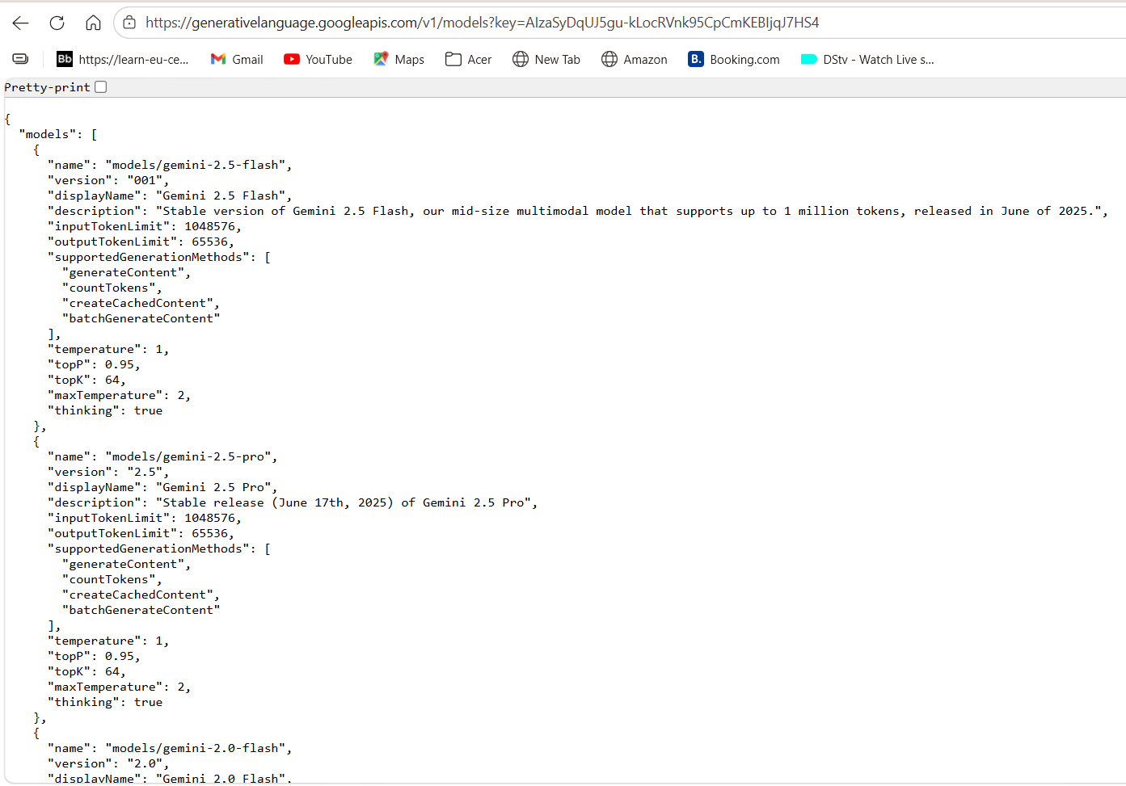

Slide 9
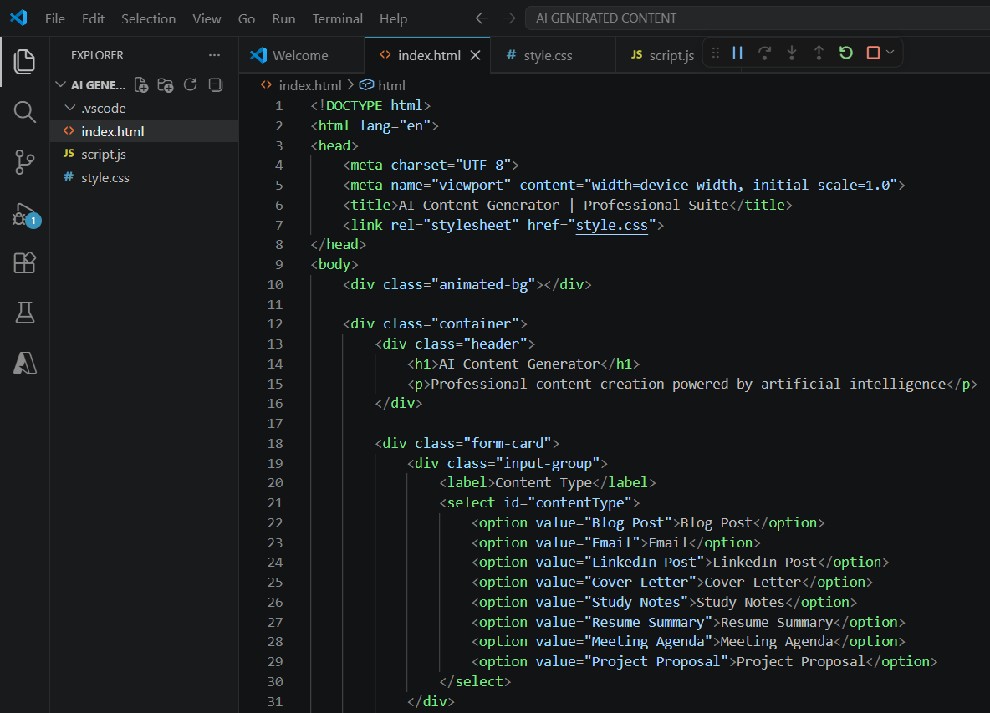

Slide 10
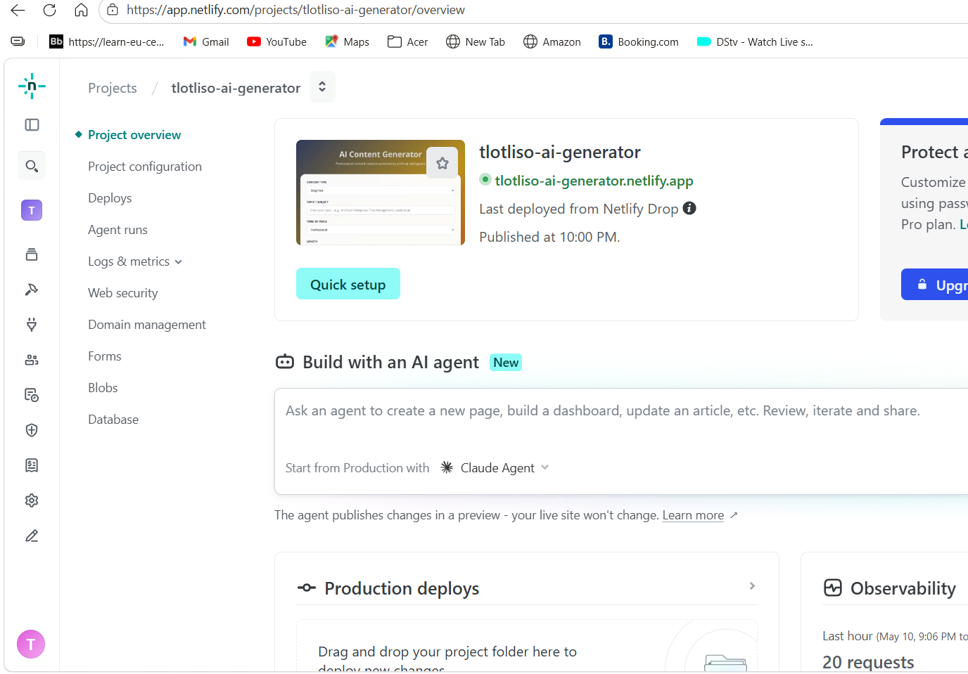

Slide 11
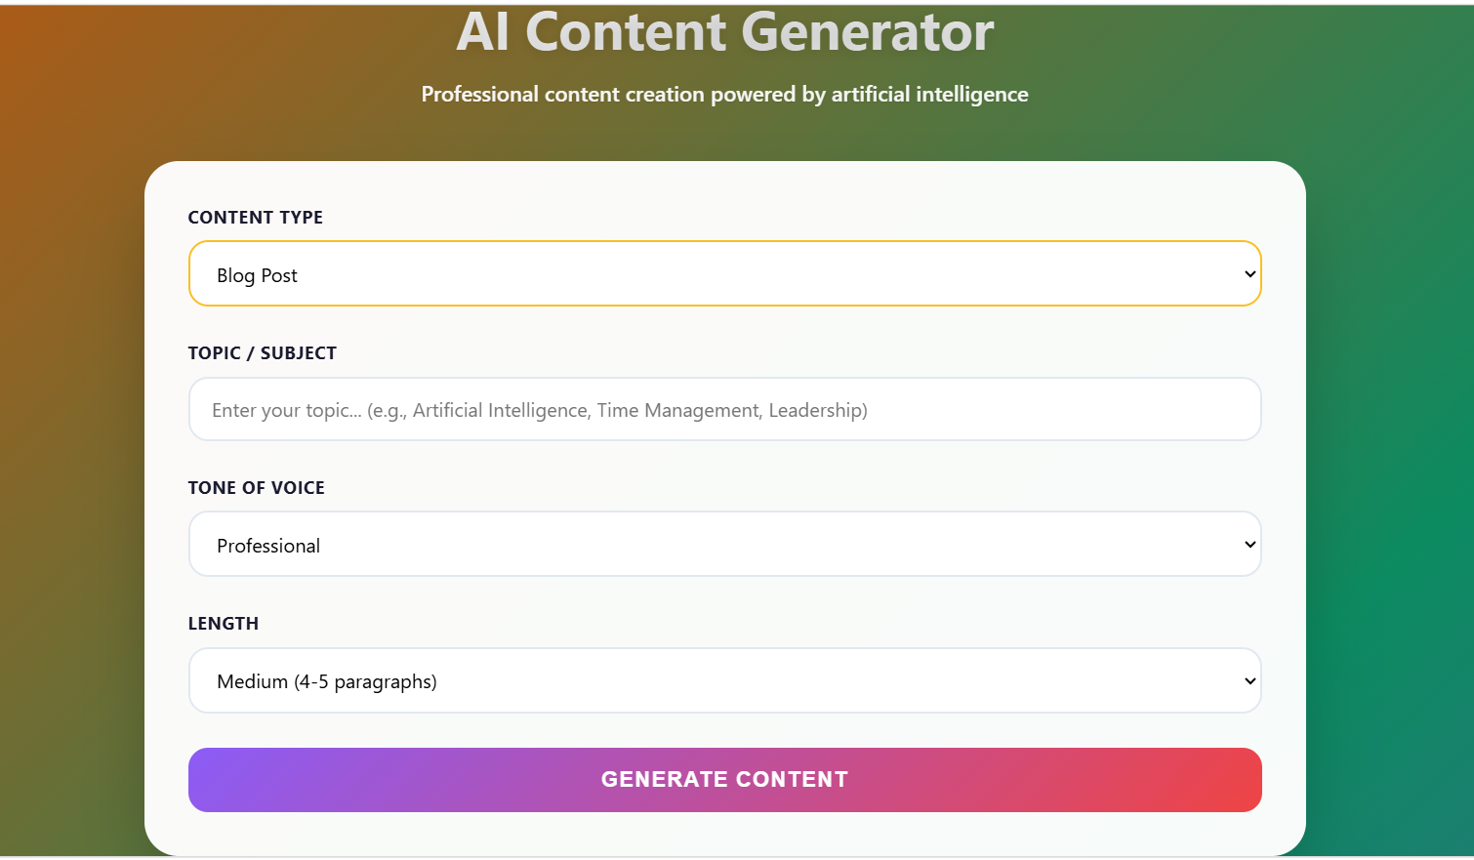

Slide 12
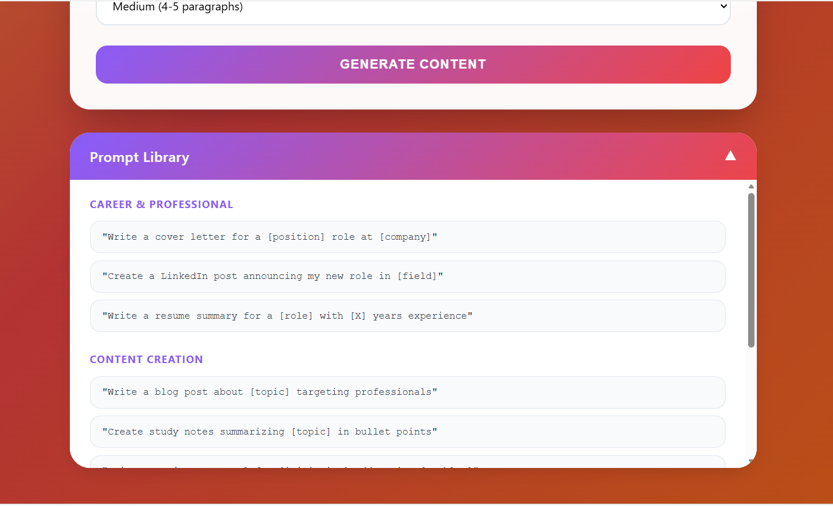

Slide 13
How to Use: Select Content Type (Blog, Email, LinkedIn, etc.) Enter your topic Choose Tone and Length Click "Generate Content" Copy result to clipboard

Slide 14
PROMPT LIBRARY What is a Prompt Library? - Career Prompts - Content Creation Prompts - Communication Prompts

Slide 15
PROMPT ENGINEERING CASE STUDY

Slide 16
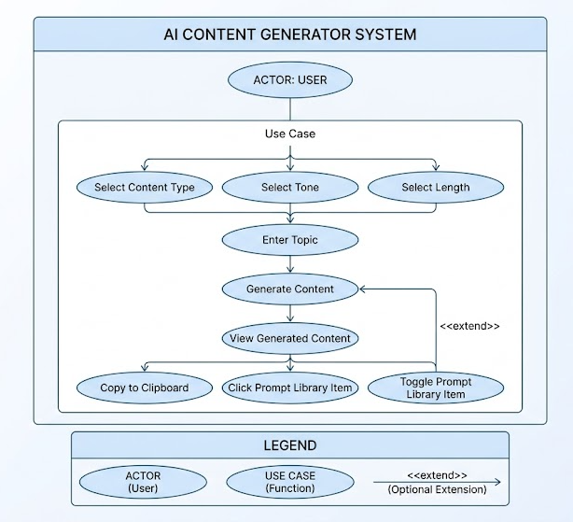


Slide 17
Live Project: https://tlotliso-ai-generator.netlify.app

Slide 18
CONCLUSION

